Slide 1
QUICK FEED
Team-3
Project Manager- Lakshmi Bhavani
Team Members- Nitesh Joshi, Akshay Sen, Saisathvik Kampati, Sayali Kanojia, Sagarika Kavali, Shubham Patil, Rohit Apuri

Slide 2
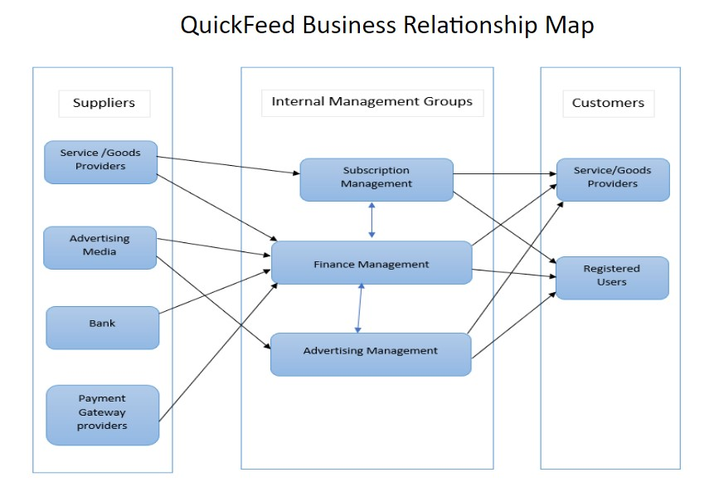
BRM - Shubham Patil

Slide 3
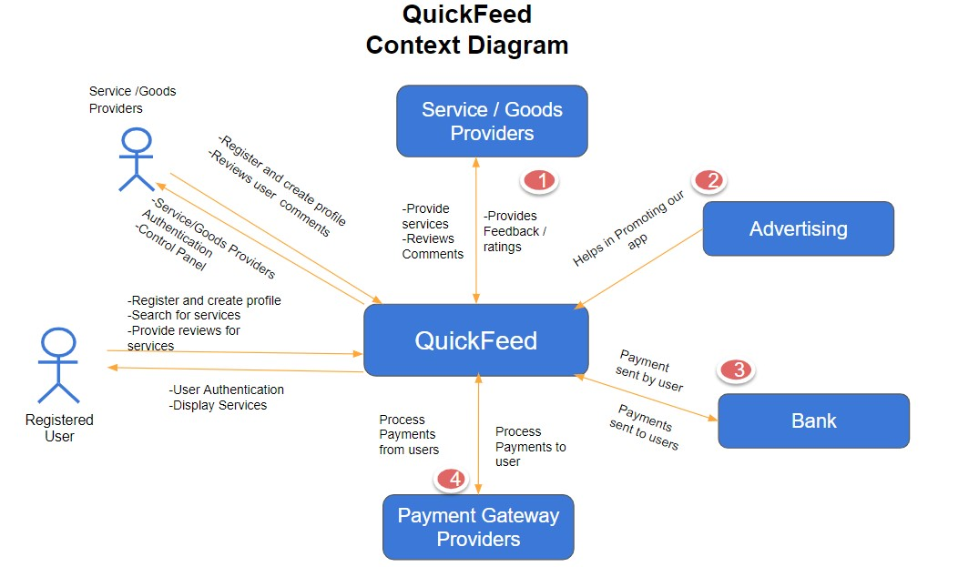
Context Diagram - Lakshmi Bhavani

Slide 4
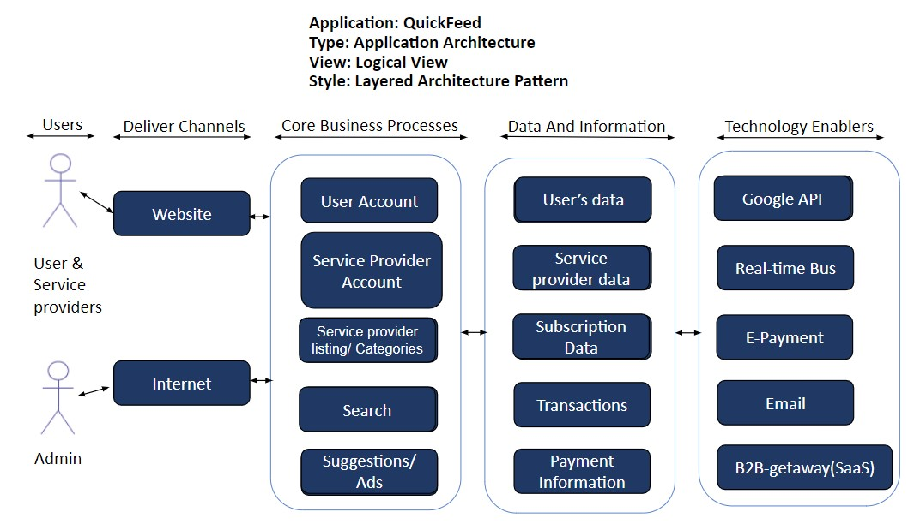
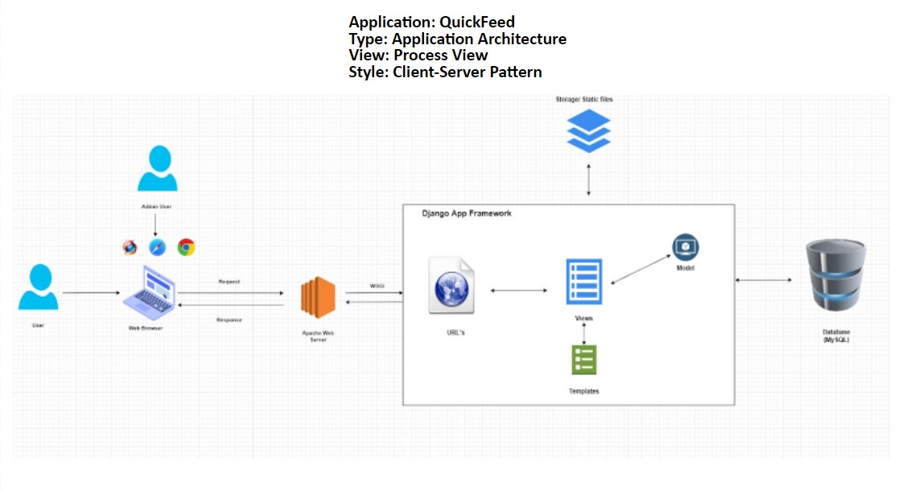
Architecture Diagrams - Sagarika

Slide 5
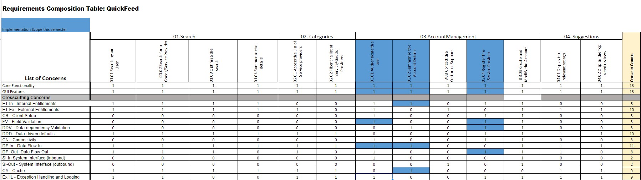
RCT - Nitesh, Sayali

Slide 6
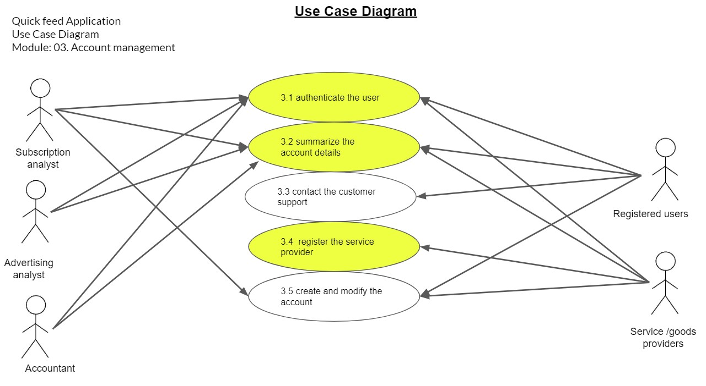
Use Case Diagram - Rohith

Slide 7
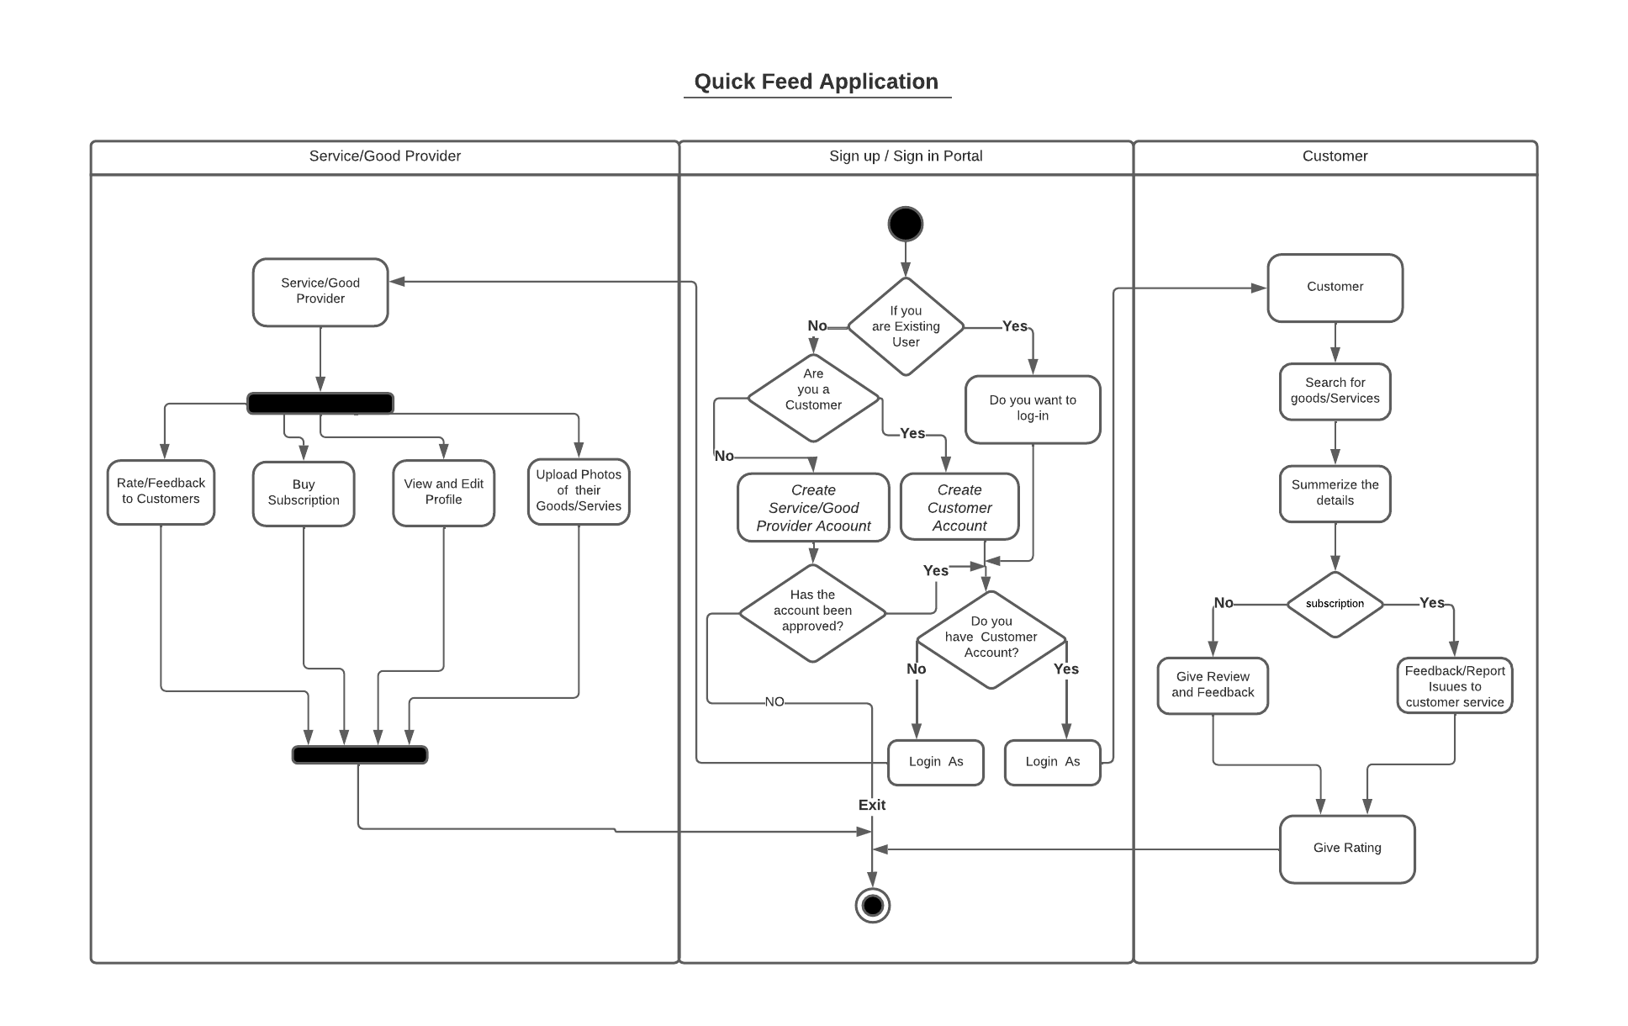
Activity Diagram - Sayali

Slide 8
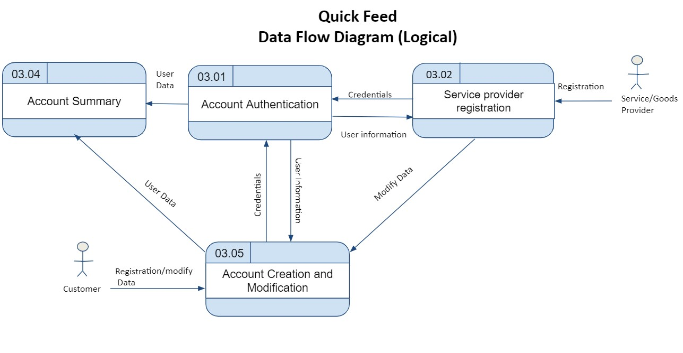
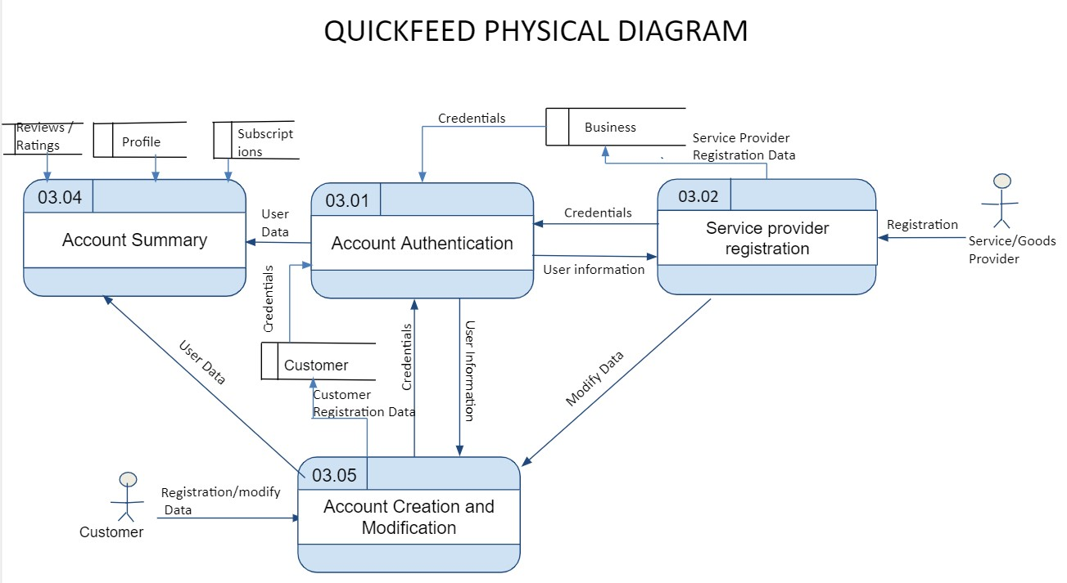
DataFeed Diagrams(logical,physical) - Shubham Patil

Slide 9
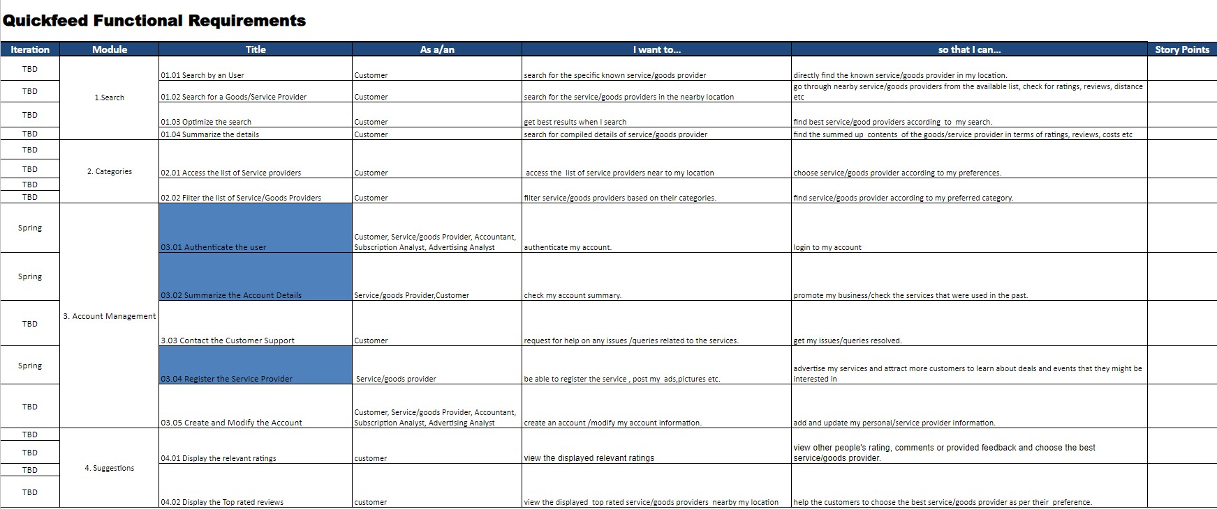
Functional Requirements - Saisathvik

Slide 10
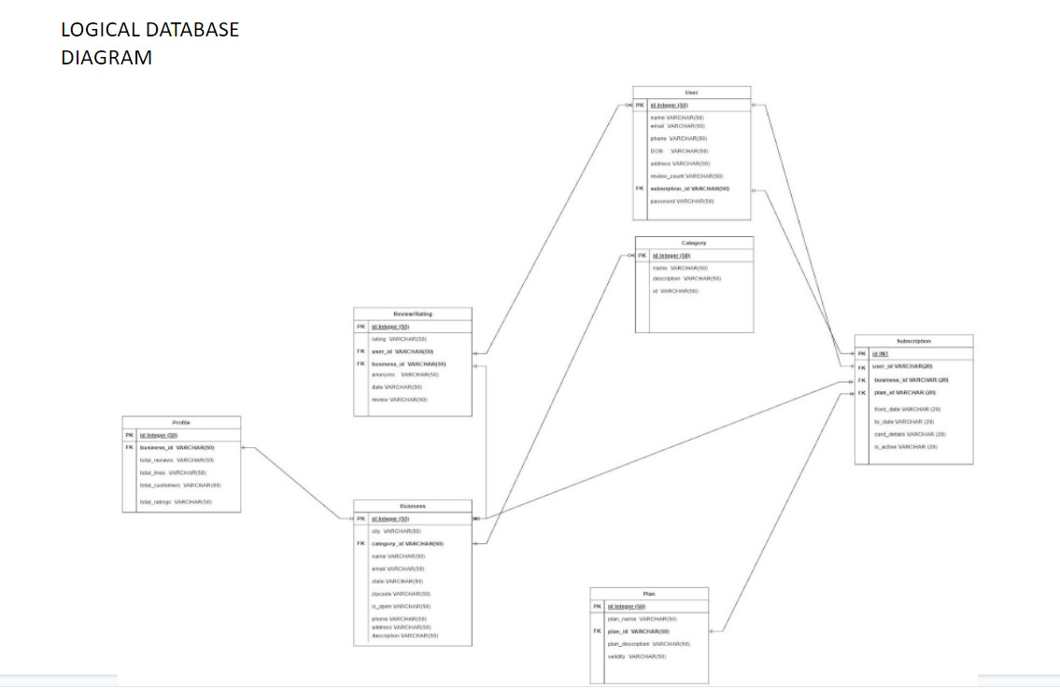
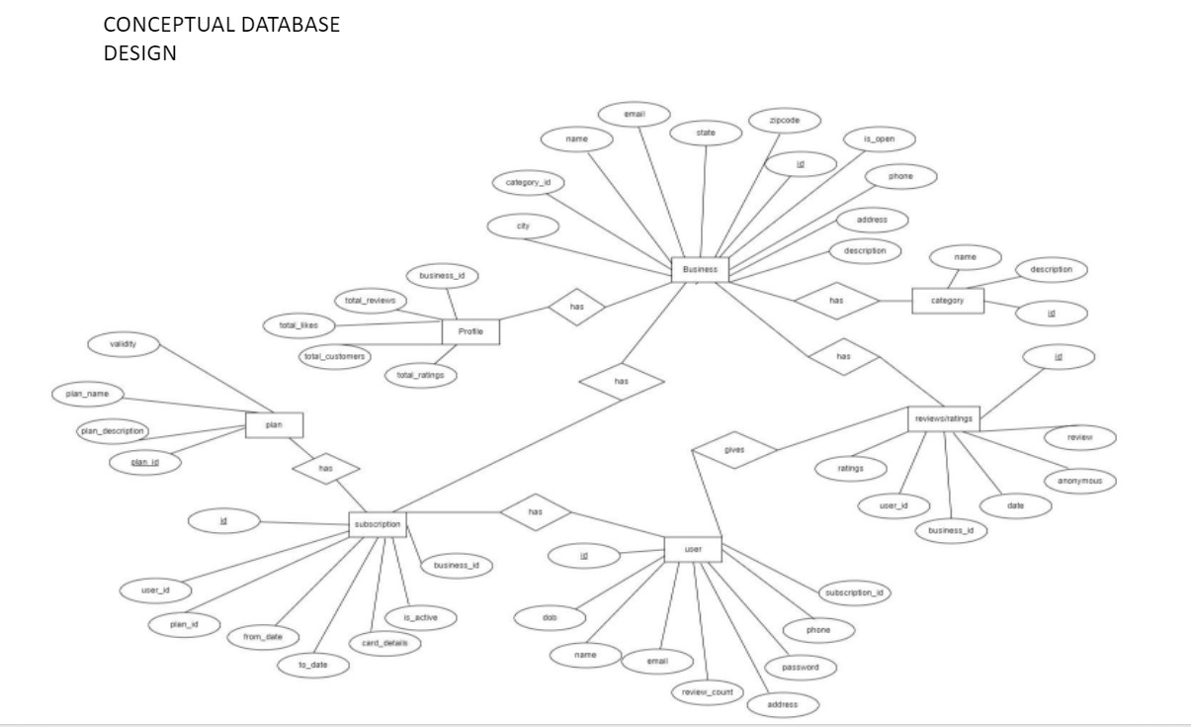
ER Diagrams - Akshay

Slide 11
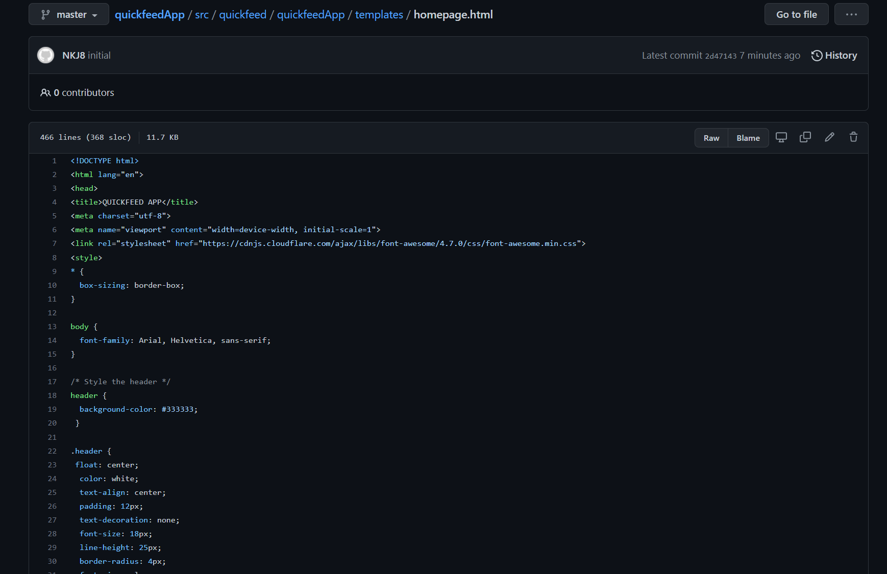
Source code - Akshay

Slide 12
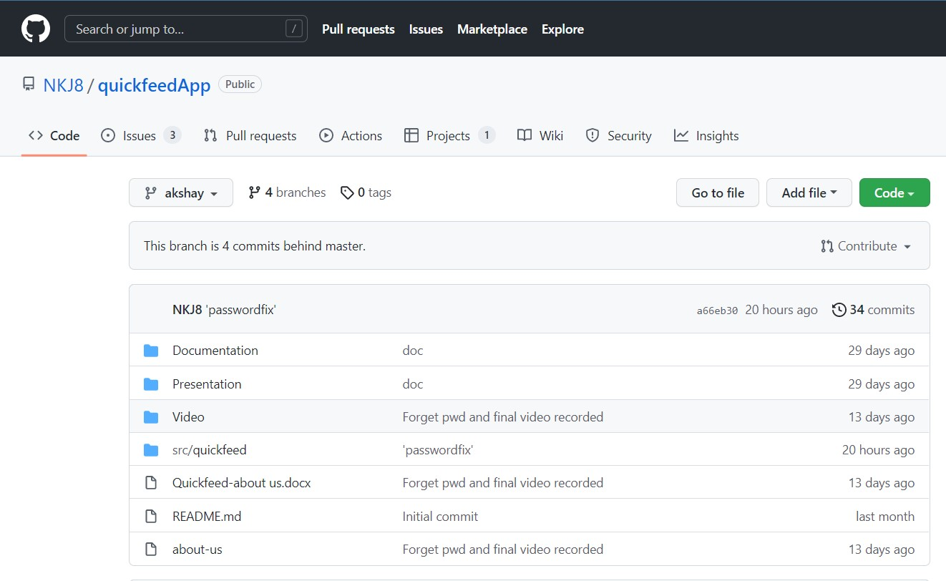
Github - Akshay

Slide 13
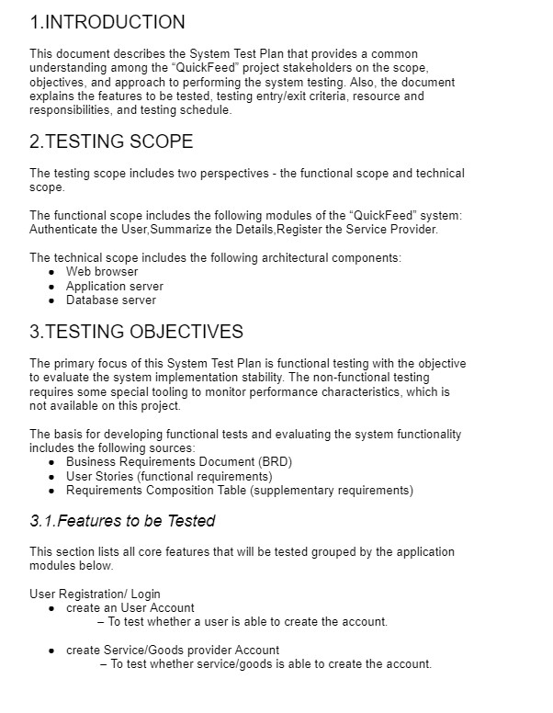
Test Plan - Lakshmi Bhavani

Slide 14
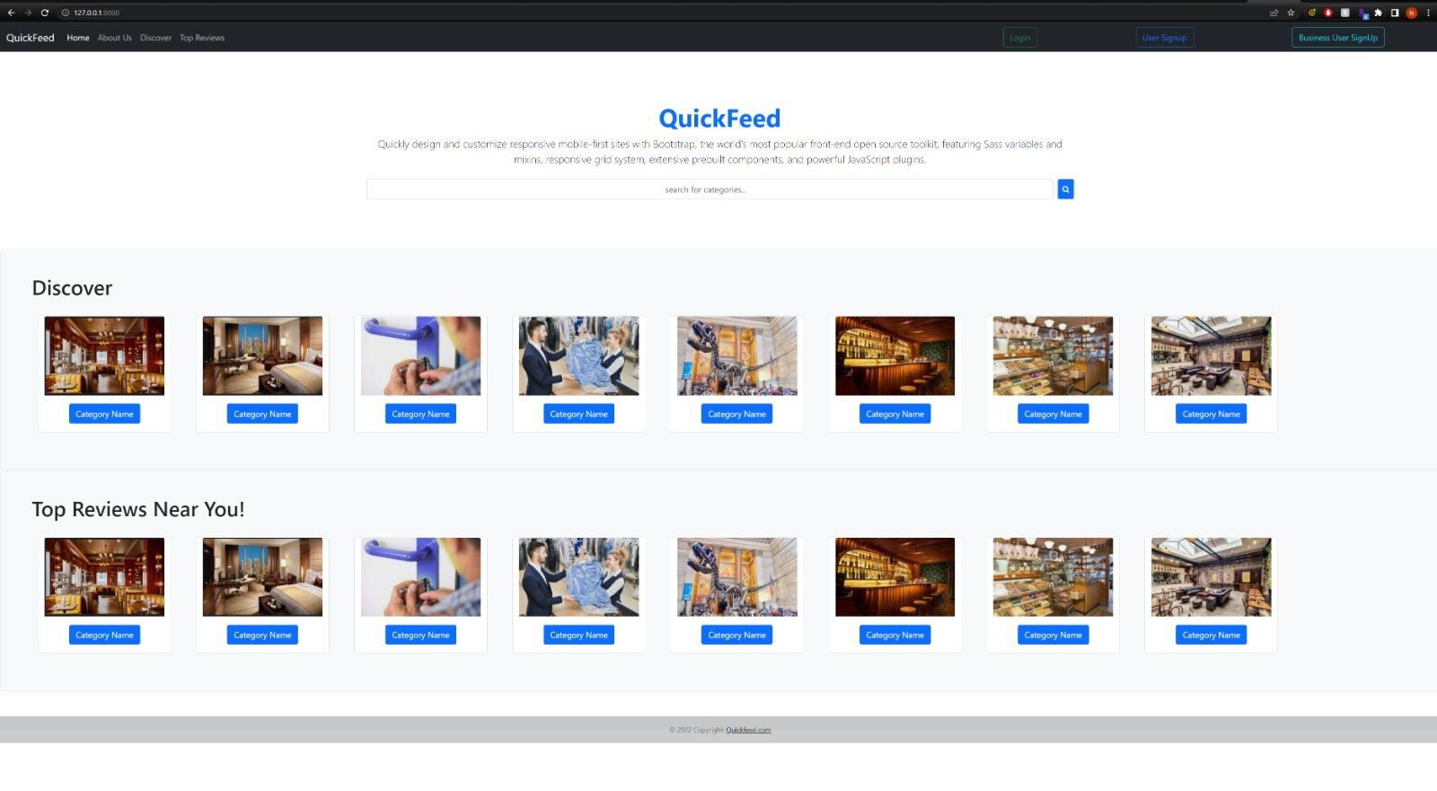
Application Demo - Nitesh

